Slide 1





Employee Data Analysis using Excel
STUDENT NAME: Sivaramakrishan.S
REGISTER NO: asunm103unm103422200022
DEPARTMENT: B.com Information Systems and Management. (3RD YEAR)
COLLEGE: S.I.V.E.T COLLEGE
1

Slide 2

PROJECT TITLE
Employee Performance Analysis using Excel
2

Slide 3



AGENDA
1.Problem Statement 2.Project Overview 3.End Users 4.Our Solution and
Proposition
5.Dataset Description 6.Modelling Approach 7.Results and Discussion 8. Conclusion
3/21/2024 Annual Review
3

Slide 4


PROBLEM STATEMENT
"Given a dataset containing employee information, including salary, the objective is to analyze the data to identify trends, disparities, and key factors influencing employee compensation. The goal is to provide actionable insights that can help in optimizing salary structures, ensuring fair compensation practices, and supporting strategic decision-making in HR management."
4

Slide 5

PROJECT OVERVIEW
.
The objective of this project is to organize, analyze, and
visualize employee data, including salary details, to support
decision-making processes regarding compensation,
workforce planning, and performance management
5

Slide 6

WHO ARE THE END USERS?
Human Resource (HR) Department
Finance Department Top
Management and Executives
Department Management and
Supervisors Auditors (Internal & External)
Employees (Limited Access)
6

Slide 7


OUR SOLUTION AND ITS VALUE PROPOSITION
OUR SOLUTION :
Our solution provides a comprehensive Excel-based tool for managing and analyzing employee salary data. It is designed to streamline payroll processes, ensure data accuracy, and enhance strategic decision-making.
VALUE PROPOSITION :
Efficiency and time savings Cost
effective solution Data driven
decision making Enhanced
transparency and compliance
Improved employee satisfaction
7

Slide 8
Dataset Description
When describing employee salary data in an Excel sheet, it’s important to provide clear labels and consistent formatting to make the data easy to understand and analyze. Here’s a typical structure and description of what each column might represent:
Work Year
Experince Level
Employee Type
Job Title
Salary -usd
Salary
Salary currency
Employee Residence
remote ratio
Company location
Company size

Slide 9

THE "WOW" IN OUR SOLUTION
It helps the management to analyze the data's of the employee and their salaries, for the record and understanding the information that have been recorded and it can be used for future purposes
3/21/2024 Annual Review
9

Slide 10


MODELLING
Pie Charts:
To show the proportion of total compensation across
different departments or roles.
Data manipulation:
Data manipulation involves cleaning, transforming,
filtering, and aggregating data for analysis.
Data manipulation:
1) Go to Insert > PivotTable.
2 )Choose the data range and where you want the
PivotTable to be placed.
3 )Drag fields into Rows, Columns, and Values areas to analyse data
10

Slide 11
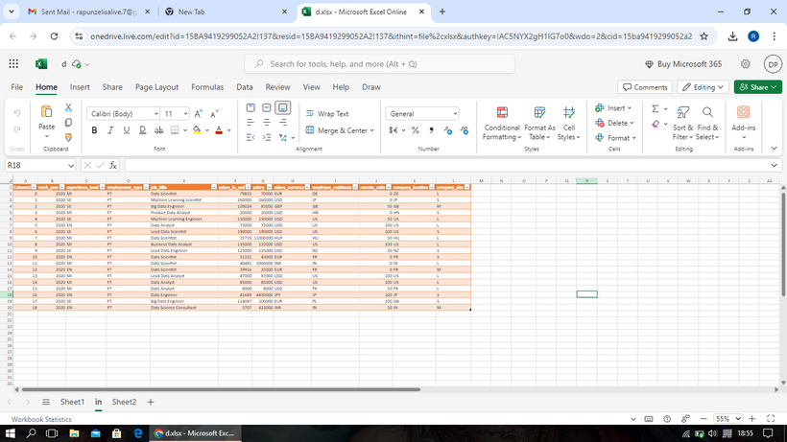
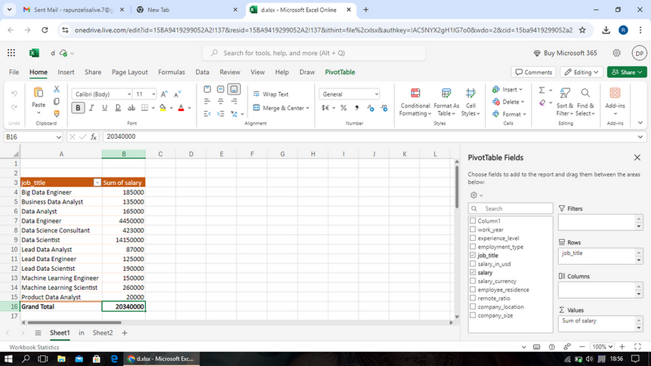
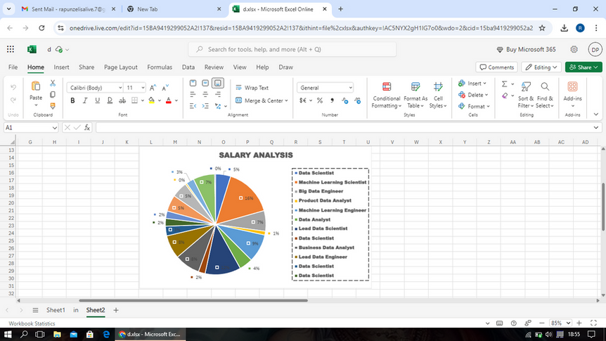
RESULTS
11

Slide 12
conclusion
Using Excel tools for analyzing employee salary data
provides a clear overview. Features such as PivotTables, charts, and data manipulation help in summarizing, visualizing, and identifying trends or outliers effectively, leading to informed decision- making.

